Slide 1
CUSTOMER SALES ANALYSYS
Vikram Meda

Slide 2
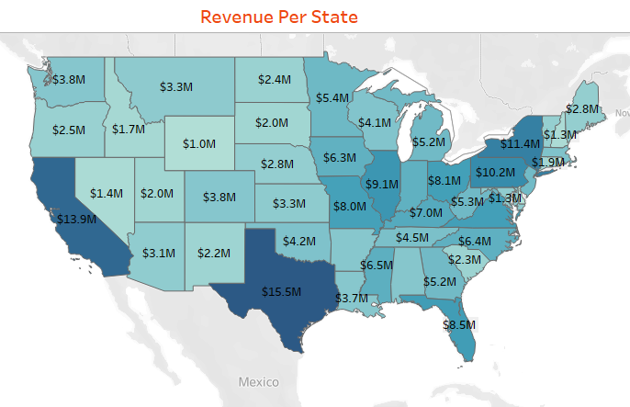
In this Sheet we can notice sales revenue at individual states. TX(Texas) has maximum sales revenue of 15.5 Millions

Slide 3
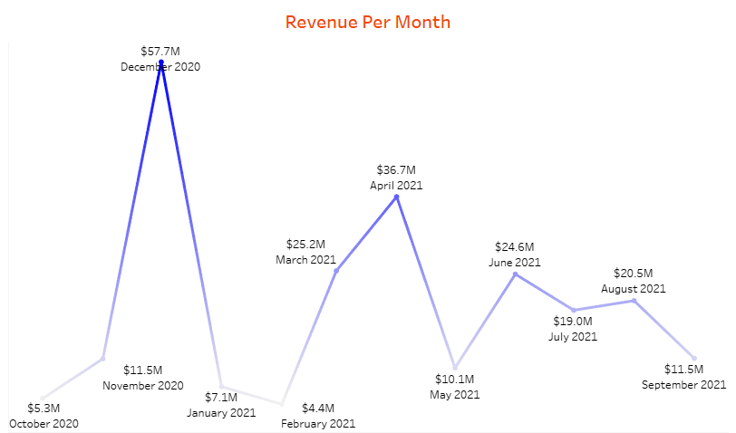
This line Graph represent the monthly sales revenue over the year.On December 2020 it reach highest revenue whereas February 2020 recorded as lowest revenue all over time

Slide 4
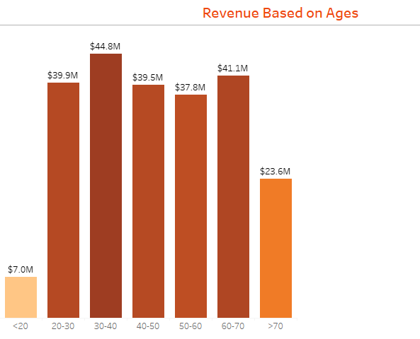
Above BAR graph represents the sales revenue based on ages. We can observed that revenue was more between ages 20 to 70. Compare to age groups less than 20 and greater than 70 age groups.

Slide 5
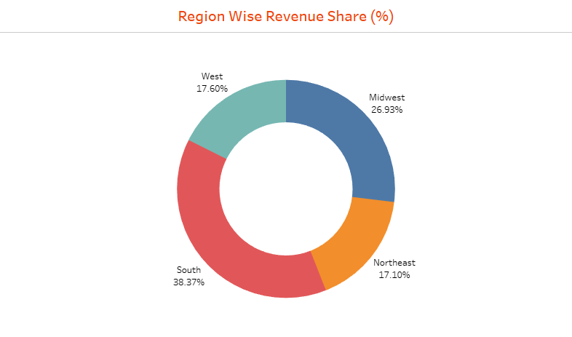
Above donut graph represented region wise sales revenue shares. South region secured 1st highest and Midwest secured 2nd highest in revenue shares with percentages of 38.37% and 26.93% respectively

Slide 6
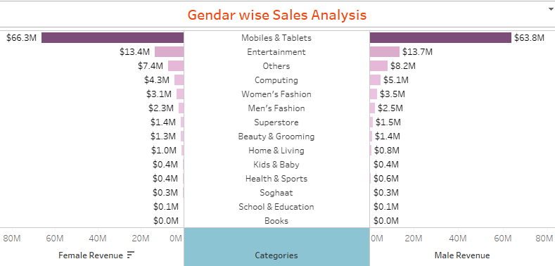
Above Butterfly graph represented the gender wise sales analysis. For all the categories through male and female secured nearly equal range of revenue. We can see mobiles & Tablets sales have bought maximum revenue compare to other categories.

Slide 7
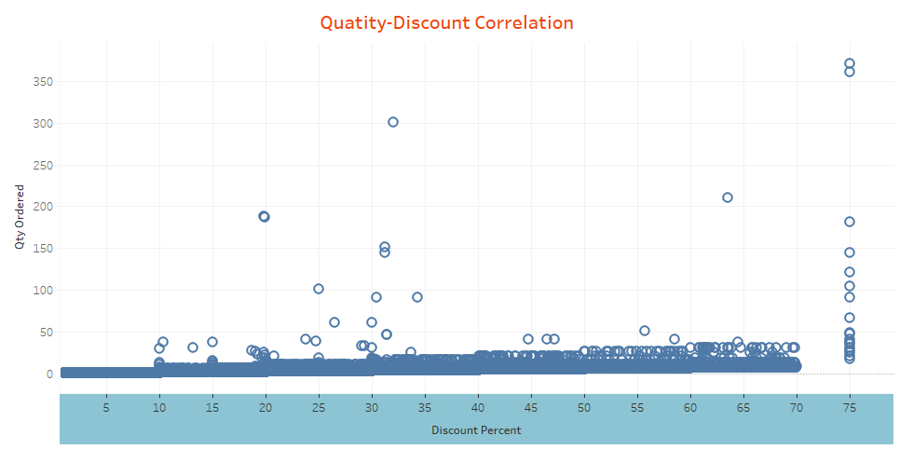
From above we can observe that correlation between Quality and Discount.In graph, Increase in discount percentages quantity also increased.discount 75 percent Quantity ordered is drastically increased.

Slide 8


